Slide 1
Ensemble learning and Random Forest

Slide 2
Supervised Learning
Goal: learn predictor h(x)
High accuracy (low error)
Using training data {(x₁,y₁),…,(x_{n},y_{n})}

Slide 3


Person | Age | Male? | Height > 55”
Alice | 14 | 0 | 1
Bob | 10 | 1 | 1
Carol | 13 | 0 | 1
Dave | 8 | 1 | 0
Erin | 11 | 0 | 0
Frank | 9 | 1 | 1
Gena | 8 | 0 | 0
Male?
Yes
No
Age>9?
Age>10?
Yes
No
Yes
No
1
0
1
0

Slide 4
Different Classifiers
Performance
None of the classifiers is perfect
Complementary
Examples that are not correctly classified by one classifier may be correctly classified by the other classifiers
Potential Improvements?
Utilize the complementary property

Slide 5
Ensembles of Classifiers
Idea
Combine the classifiers to improve the performance
Ensembles of Classifiers
Combine the classification results from different classifiers to produce the final output
Unweighted voting
Weighted voting

Slide 6


Example: Weather Forecast
Reality
1
2
3
4
5
Combine
X
X
X
X
X
X
X
X
X
X
X
X
X

Slide 7

Ensemble learning
When you want to purchase a new Mobile.
will you walk up to the first Mobile shop and purchase one based on the advice of the dealer?
It’s highly unlikely.
You would likely browser a few web portals where people have posted their reviews and compared different Mobiles models, checking for their features and prices.
You will also probably ask your friends and colleagues for their opinion. In short, you wouldn’t directly reach a conclusion.
Ensemble models in machine learning operate on a similar idea.
You will instead make a decision considering the opinions of other people as well.

Slide 8
Ensemble learning
Ensemble learning is a general meta approach to machine learning that seeks better predictive performance by combining the predictions from multiple models.
It combines the decisions from multiple models to improve the overall performance.
Ensemble learning is primarily used to improve the (classification, prediction, function approximation, etc.) performance of a model, or reduce the likelihood of an unfortunate selection of a poor one.

Slide 9
Ensemble learning
Simple Ensemble Techniques
Max Voting
Averaging
Weighted Averaging
Advanced Ensemble Techniques
Stacking
Bagging
Boosting

Slide 10
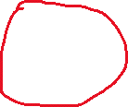
Simple Ensemble Techniques
Max Voting
The max voting method is generally used for classification problems.
In this technique, multiple models are used to make predictions for each data point.
The predictions by each model are considered as a ‘vote’. The predictions which we get from the majority of the models are used as the final prediction.
For example, when you asked 5 of your friends to rate your movie (out of 5)
Friend 1 Friend 2 Friend 3 Friend 4 Friend 5 Final
5 4 5 4 4 4

Slide 11

Simple Ensemble Techniques
Averaging
Similar to the max voting technique, multiple predictions are made for each data point in averaging,
In this method, we take an average of predictions from all the models and use it to make the final prediction.
Averaging can be used for making predictions in regression problems or while calculating probabilities for classification problems.
For example, in the below case, the averaging method would take the average of all the values.
i.e. (4+5+4+4+5)/5 = 4.4
Friend 1 Friend 2 Friend 3 Friend 4 Friend 5 Final
5 4 5 4 4 4.4

Slide 12
Simple Ensemble Techniques
Weighted Average
This is an extension of the averaging method.
All models are assigned different weights defining the importance of each model for prediction.
For instance, if two of your friends are critics, while others have no prior experience in this field, then the answers by these two friends are given more importance as compared to the other people.
The result is calculated as [(5*0.23) + (4*0.23) + (5*0.18) + (4*0.18) + (4*0.18)] = 4.41.

Slide 13
Advanced Ensemble techniques
Stacking
Stacking is an ensemble learning technique that uses predictions from multiple models (for the example decision tree, knn, or SVM ) to build a new model.
Stacking involves fitting many different model types on the same data and using another model to learn how to best combine the predictions.

Slide 14
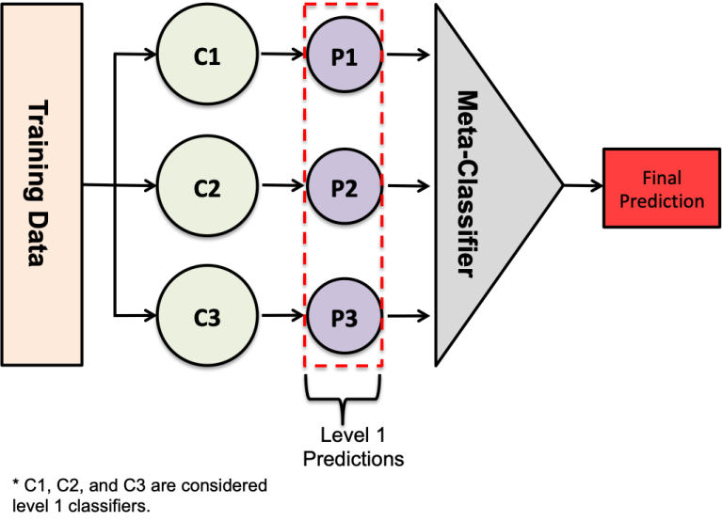
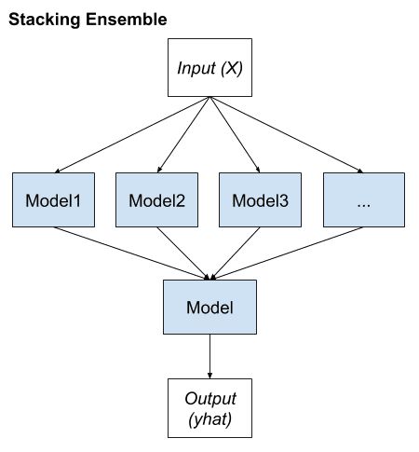
Advanced Ensemble techniques
Stacking
key elements of stacking
Unchanged training dataset.
Different machine learning algorithms for each ensemble member.
Machine learning model to learn how to best combine predictions.

Slide 15
Advanced Ensemble techniques
Stacking can be considered to happen in the following steps:
Split the data into a training and validation set,
Divide the training set into K folds, for example 10,
Train a base model (say SVM) on 9 folds and make predictions on the 10th fold,
Repeat until you have a prediction for each fold,
Fit the base model on the whole training set,
Use the model to make predictions on the test set,
Repeat step 3 – 6 for other base models (for example decision trees),
Use predictions from the test set as features to a new model – the meta-model,
Make final predictions on the test set using the meta model.

Slide 16
Advanced Ensemble techniques
Bagging Ensemble Learning (Bootstrap AGGregating)
It combines Bootstrapping and Aggregation to form one ensemble model.
Bootstrapping is a sampling technique in which we create subsets of observations from the original dataset, with replacement. The size of the subsets is the same as the size of the original set.
The diversity of classifiers in bagging is obtained by using bootstrapped replicas of the training data.

Slide 17
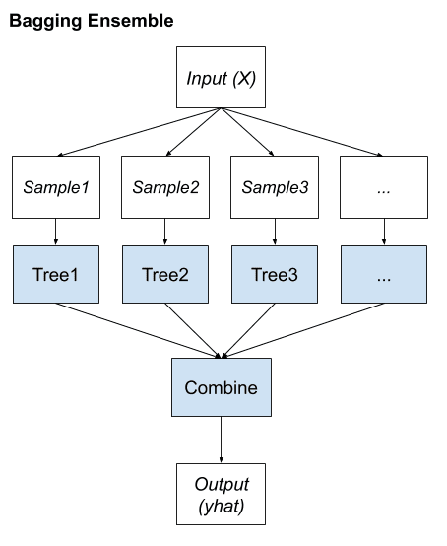
Bagging Ensemble Learning (Bootstrap AGGregating)
key elements of bagging
Bootstrap samples of the training dataset.
Unpruned decision trees fit on each sample.
Simple voting or averaging of predictions..
Many popular ensemble algorithms are based on this approach
Bagged Decision Trees (canonical bagging)
Random Forest
Extra Trees.

Slide 18
Bagging Ensemble Learning (Bootstrap AGGregating)
Bagging can be considered to happen in the following steps:
Multiple subsets are created from the original dataset, selecting observations with replacements.
A base model (weak model) is created on each of these subsets.
The models run in parallel and are independent of each other.
The final predictions are determined by combining the predictions from all the models.

Slide 19
Boosting Ensemble Learning
Boosting is a machine learning ensemble technique that by converting weak learners into strong learners. reduces bias and variance
The weak learners are applied to the dataset in a sequential manner.
The first step is building an initial model and fitting it into the training set.
A second model that tries to fix the errors generated by the first model is then fitted.

Slide 20
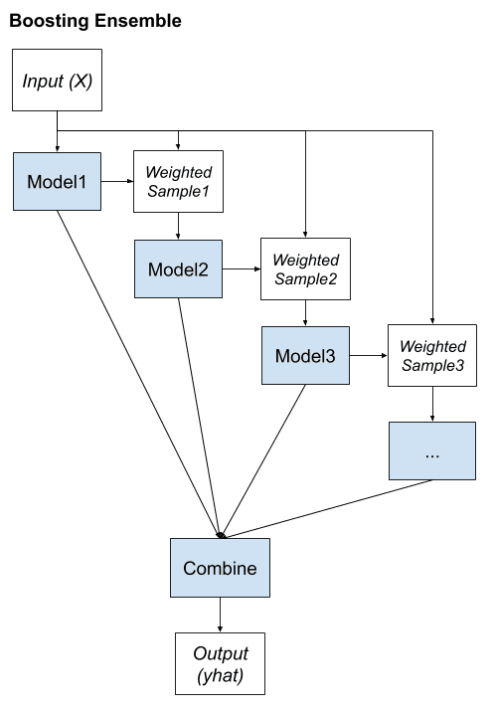
Boosting Ensemble Learning
key elements of Boosting
Bias training data toward those examples that are hard to predict.
Iteratively add ensemble members to correct predictions of prior models.
Combine predictions using a weighted average of models.
Many popular ensemble algorithms are based on this approach
AdaBoost (canonical boosting)
Gradient Boosting Machines
Stochastic Gradient Boosting (XGBoost and similar)

Slide 21
Boosting Ensemble Learning
Boosting can be considered to happen in the following steps:
Create a subset from the original data,
Build an initial model with this data,
Run predictions on the whole data set,
Calculate the error using the predictions and the actual values,
Assign more weight to the incorrect predictions,
Create another model that attempts to fix errors from the last model,
Run predictions on the entire dataset with the new model,
Create several models with each model aiming at correcting the errors generated by the previous one,
Obtain the final model by weighting the mean of all the models.

Slide 22
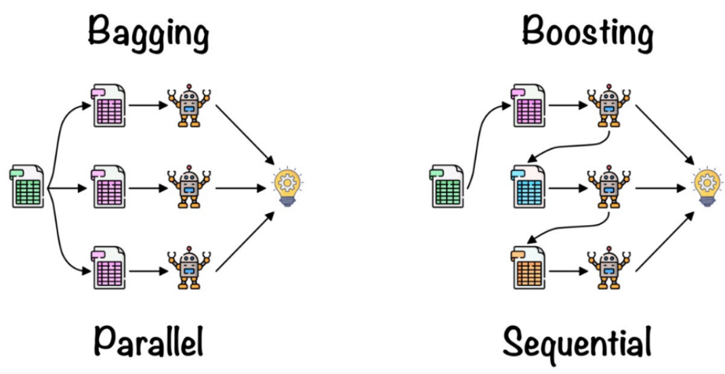
Bagging Vs Boosting

Slide 23
Prediction error
Prediction error
Bias
Variance
Overfitting and underfitting
Total error
Reducible error
Irreducible error
Bayes’ error rate
Optimum Error rate
Bias error
Variance error

Slide 24
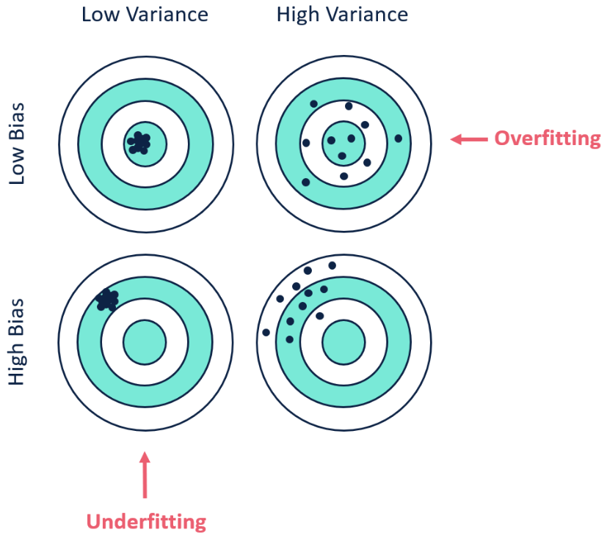
Bias and variance
Bias error
How far is the predicted value from the true value
The systematic error of the model
It is about the model and the data itself
Variance error
The error is caused by sensitivity to small variances in the training data set.
The dispersion of predicted values over target values with different train sets.
It is about the model sensitivity.

Slide 25
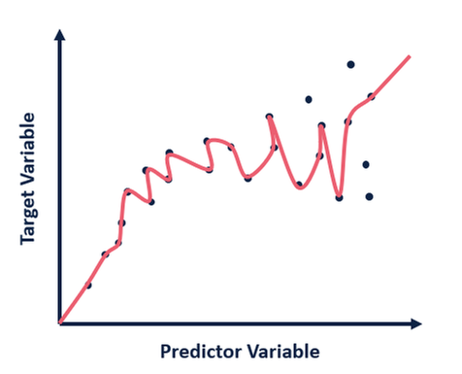
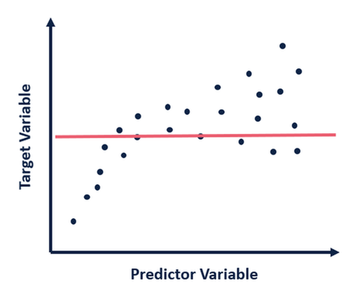
Random forest classifier
Overfitting and underfitting
Overfitting occurs when the model captures the noise and the outliers in the data along with the underlying pattern.
These models usually have high variance and low bias.
Under fitting occurs when The model is unable to capture the underlying pattern of the data. These models usually have low variance and a high bias.

Slide 26
Ensemble Learning Algorithms
Bias/Variance Tradeoff
Ensemble methods that minimize the variance
Bagging
Random Forests
Ensemble methods that minimize bias
Functional Gradient Descent
Boosting
Ensemble Selection

Slide 27
Ensemble Learning Algorithms
Generalization Error
“True” distribution: P(x,y)
Unknown to us
Train: h(x) = y
Using training data S = {(x₁,y₁),…,(x_{n},y_{n})}
Sampled from P(x,y)
Generalization Error:
L(h) = E_{(x,y)~P(x,y)}[ f(h(x),y) ]
E.g., f(a,b) = (a-b)²

Slide 28
Person | Age | Male? | Height > 55”
James | 11 | 1 | 1
Jessica | 14 | 0 | 1
Alice | 14 | 0 | 1
Amy | 12 | 0 | 1
Bob | 10 | 1 | 1
Xavier | 9 | 1 | 0
Cathy | 9 | 0 | 1
Carol | 13 | 0 | 1
Eugene | 13 | 1 | 0
Rafael | 12 | 1 | 1
Dave | 8 | 1 | 0
Peter | 9 | 1 | 0
Henry | 13 | 1 | 0
Erin | 11 | 0 | 0
Rose | 7 | 0 | 0
Iain | 8 | 1 | 1
Paulo | 12 | 1 | 0
Margaret | 10 | 0 | 1
Frank | 9 | 1 | 1
Jill | 13 | 0 | 0
Leon | 10 | 1 | 0
Sarah | 12 | 0 | 0
Gena | 8 | 0 | 0
Patrick | 5 | 1 | 1
Person | Age | Male? | Height > 55”
Alice | 14 | 0 | 1
Bob | 10 | 1 | 1
Carol | 13 | 0 | 1
Dave | 8 | 1 | 0
Erin | 11 | 0 | 0
Frank | 9 | 1 | 1
Gena | 8 | 0 | 0
y
h(x)
Generalization Error:
L(h) = E_{(x,y)~P(x,y)}[ f(h(x),y) ]
…

Slide 29
Bias/Variance Tradeoff
Treat h(x|S) has a random function
Depends on training data S
L = E_{S}[ E_{(x,y)~P(x,y)}[ f(h(x|S),y) ] ]
Expected generalization error
Over the randomness of S

Slide 30
Bias/Variance Tradeoff
Squared loss: f(a,b) = (a-b)²
Consider one data point (x,y)
Notation:
Z = h(x|S) – y
ž = E_{S}[Z]
Z-ž = h(x|S) – E_{S}[h(x|S)]
Expected Error
E_{S}[(Z-ž)²] = E_{S}[Z² – 2Zž + ž²]
= E_{S}[Z²] – 2E_{S}[Z]ž + ž²
= E_{S}[Z²] – ž²
E_{S}[f(h(x|S),y)] = E_{S}[Z²]
= E_{S}[(Z-ž)²] + ž²
Bias/Variance for all (x,y) is expectation over P(x,y).
Can also incorporate measurement noise.
(Similar flavor of analysis for other loss functions.)
Variance
Bias

Slide 31
Random Forest Algorithm
A random forest is a supervised machine learning algorithm that is constructed from decision tree algorithms.
This algorithm is applied in various industries such as banking and e-commerce to predict behavior and outcomes.
It utilizes ensemble learning, which is a technique that combines many classifiers to provide solutions to complex problems.
A random forest algorithm consists of many decision trees.
The random forest algorithm is trained through bagging or bootstrap aggregating.

Slide 32
Features of a Random Forest Algorithm
It’s more accurate than the decision tree algorithm.
It provides an effective way of handling missing data.
It can produce a reasonable prediction without hyper-parameter tuning.
It solves the issue of overfitting in decision trees.
In every random forest tree, a subset of features is selected randomly at the node’s splitting point.

Slide 33
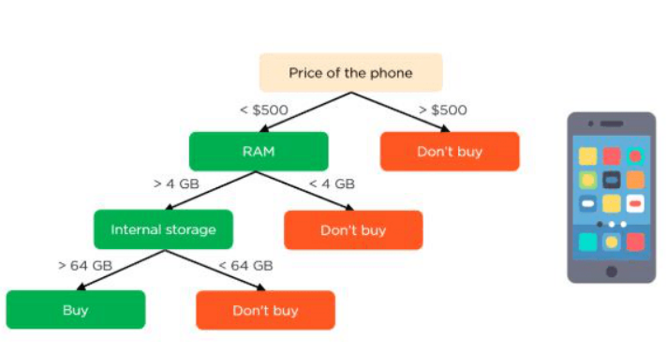
How random forest algorithm works
Decision trees are the building blocks of a random forest algorithm.
A decision tree is a decision support technique that forms a tree-like structure.

Slide 34
Applying decision trees in random forest
The main difference between the decision tree algorithm and the random forest algorithm is that establishing root nodes and segregating nodes is done randomly in the latter.
The random forest employs the bagging method to generate the required prediction.
Bagging involves using different samples of data (training data) rather than just one sample.
The decision trees produce different outputs, depending on the training data fed to the random forest algorithm.
These outputs will be ranked, and the highest will be selected as the final output.

Slide 35
Steps involved in random forest algorithm:
Step 1: In Random forest n number of random records are taken from the data set having k number of records.
Step 2: Individual decision trees are constructed for each sample.
Step 3: Each decision tree will generate an output.
Step 4: Final output is considered based on Majority Voting or Averaging for Classification and regression respectively.

Slide 36
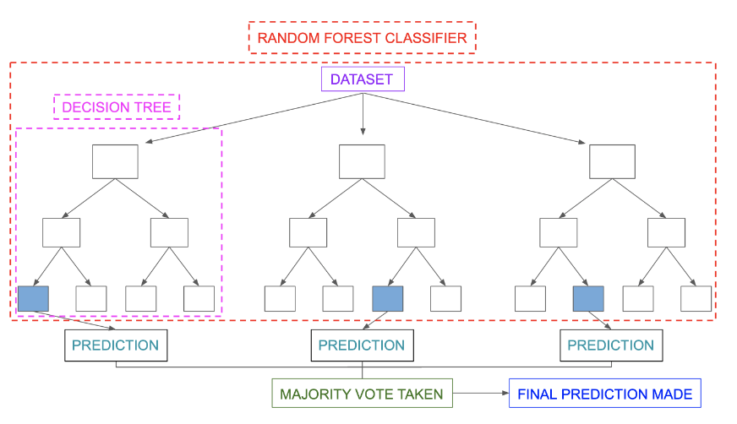
Classification in random forests
The leaf node of each tree is the final output produced by that specific decision tree. The selection of the final output follows the majority-voting system.

Slide 37
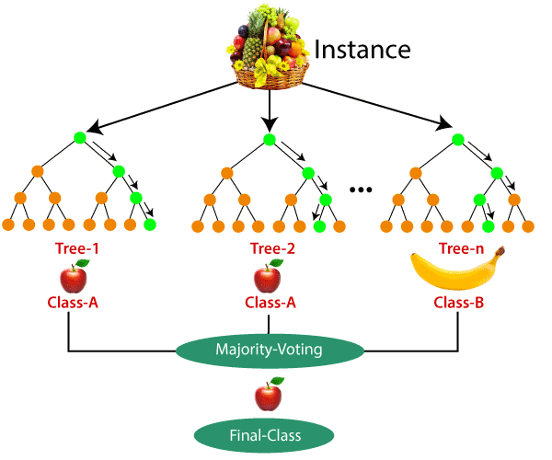
Example

Slide 38
Advantages of random forest
It can perform both regression and classification tasks.
A random forest produces good predictions that can be understood easily.
It can handle large datasets efficiently.
The random forest algorithm provides a higher level of accuracy in predicting outcomes over the decision tree algorithm.

Slide 39
Disadvantages of random forest
When using a random forest, more resources are required for computation.
It consumes more time compared to a decision tree algorithm.

Slide 40
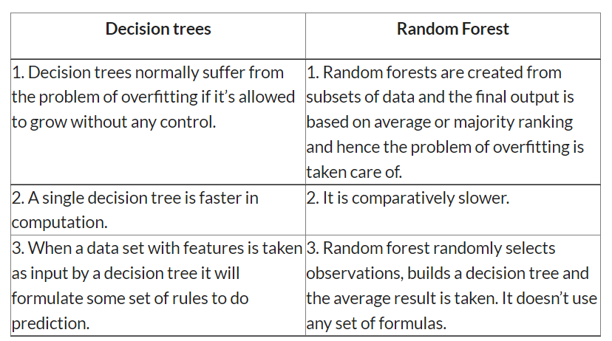
Difference Between Decision Tree & Random Forest

Slide 41
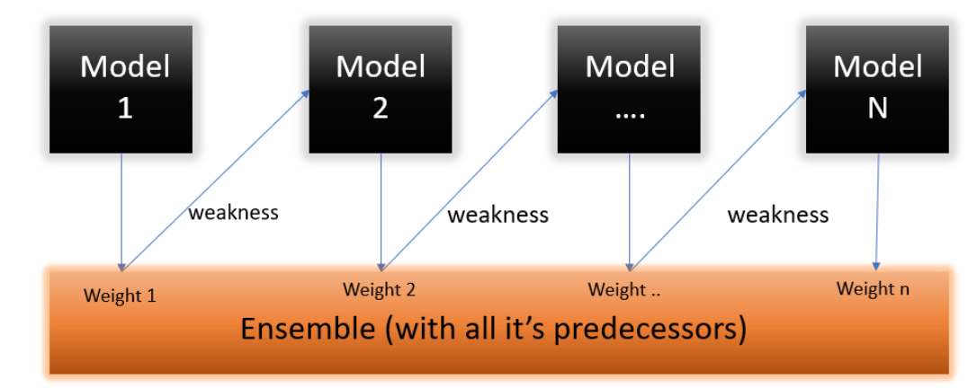
AdaBoost Algorithm
AdaBoost also called Adaptive Boosting is a technique in Machine Learning used as an Ensemble Method.
The most common algorithm used with AdaBoost is decision trees with one level which means Decision trees with only 1 split. These trees are also called Decision Stumps.

Slide 42
Initial Distribution of Data
Train model
Error of model
Coefficient of model
Update Distribution
Final average
Theorem: training error drops exponentially fast

Slide 43
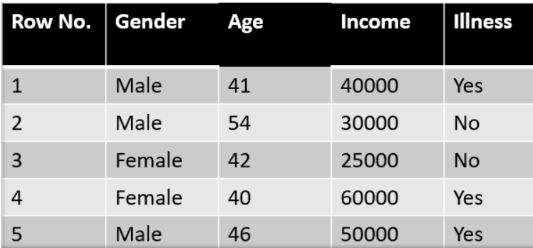
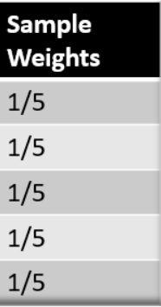
Understanding the working of the AdaBoost Algorithm
Step 1 – The table shown below is the actual representation of our dataset.
Since the target column is binary it is a classification problem.
First of all these data points will be assigned some weights. Initially, all the weights will be equal.

Slide 44
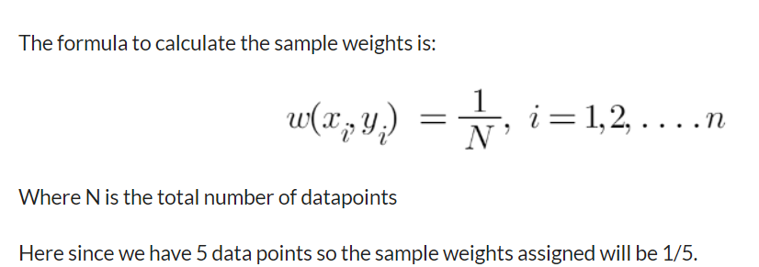
Step 2 – We start by seeing how well “Gender” classifies the samples and will see how the variables (Age, Income) classify the samples.
We’ll create a decision stump for each of the features and then calculate the Gini Index of each tree. The tree with the lowest Gini Index will be our first stump.
Here in our dataset let’s say Gender has the lowest gini index so it will be our first stump.

Slide 45
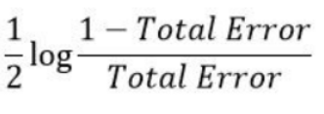
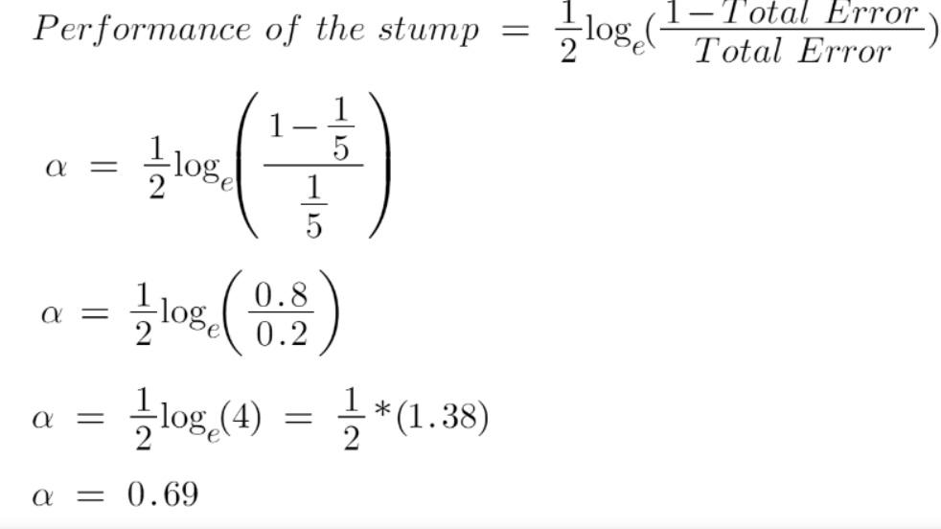
Step 3 – We’ll now calculate the “Amount of Say” or “Importance” or “Influence” for this classifier in classifying the data points using this formula:
The total error is nothing, but the summation of all the sample weights of misclassified data points.
Here in our dataset let’s assume there is 1 wrong output, so our total error will be 1/5, and alpha(performance of the stump) will be:

Slide 46
Step 4 : we need to update the weights, The wrong predictions will be given more weight whereas the correct prediction’s weights will be decreased.
After finding the importance of the classifier and total error we need to finally update the weights and for this, we use the following formula:
The amount of say (alpha) will be negative when the sample is correctly classified.
The amount of say (alpha) will be positive when the sample is miss-classified.

Slide 47
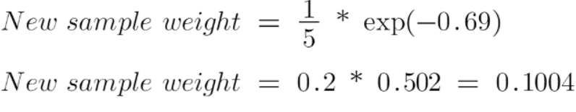
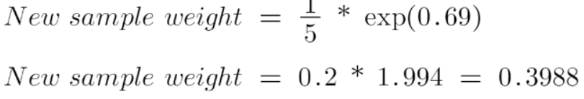
There are four correctly classified samples and 1 wrong, here the sample weight of that datapoint is 1/5 and the amount of say/performance of the stump of Gender is 0.69.
New weights for correctly classified samples are:
For wrongly classified samples the updated weights will be:

Slide 48
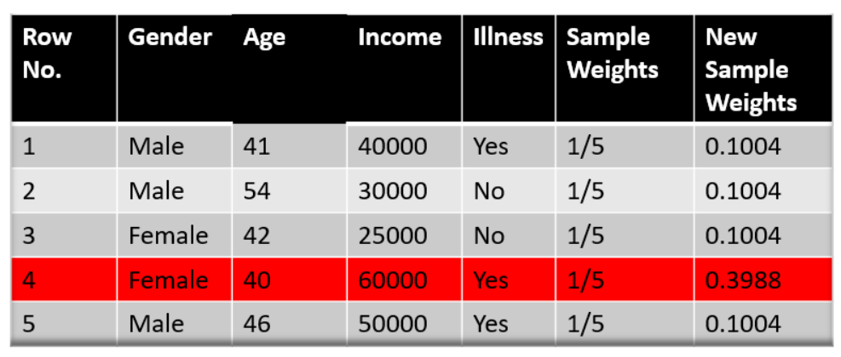
We know that the total sum of the sample weights must be equal to 1 but here if we sum up all the new sample weights, we will get 0.8004.
To bring this sum equal to 1 we will normalize these weights by dividing all the weights by the total sum of updated weights which is 0.8004.

Slide 49
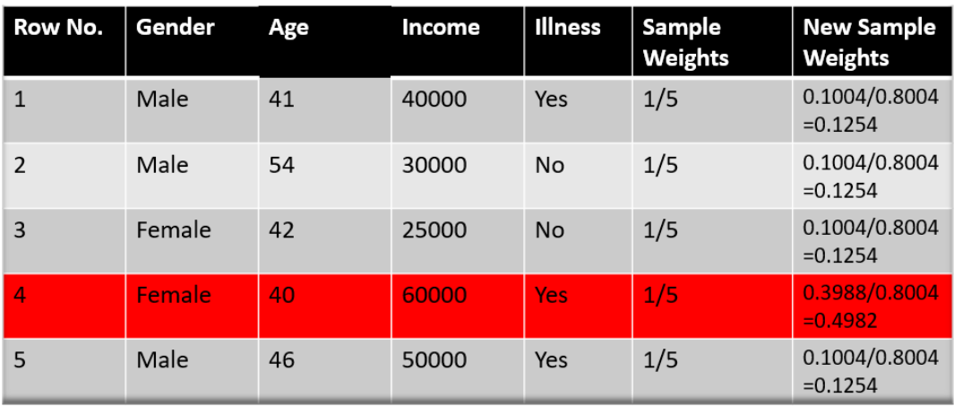
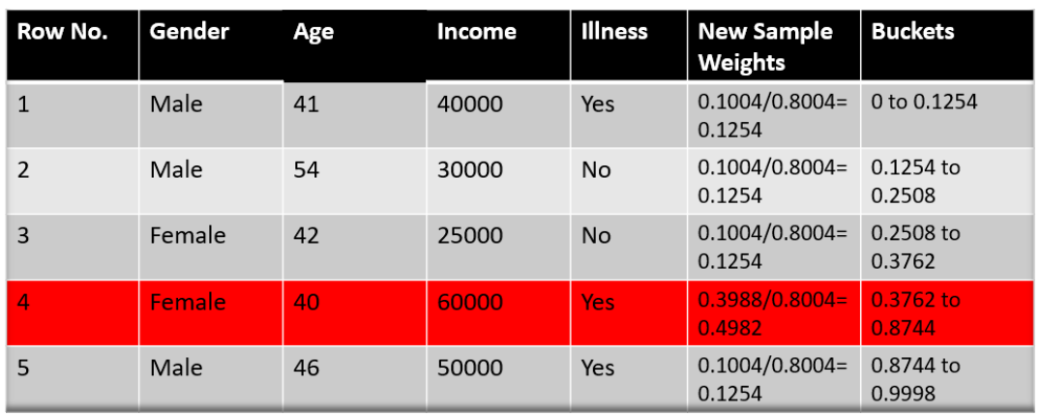
Now we need to make a new dataset to see if the errors decreased or not.
For this we will remove the “sample weights” and “new sample weights” column and then based on the “new sample weights” we will divide our data points into buckets.

Slide 50
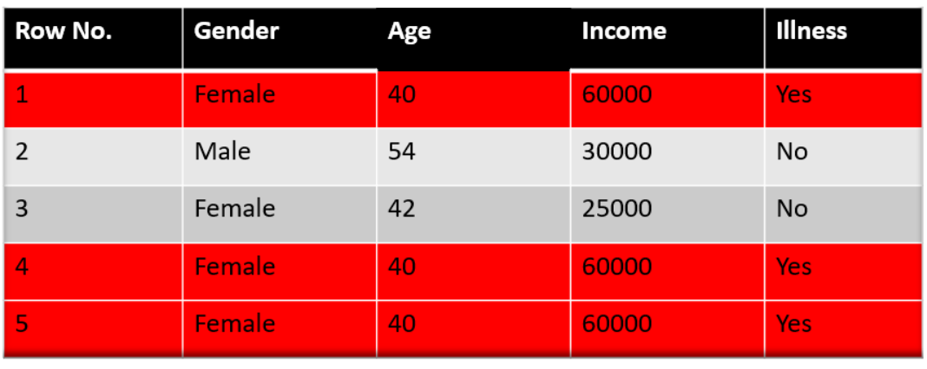
Step 6 – We are almost done, now what the algorithm does is select random numbers from 0-1. Since incorrectly classified records have higher sample weights, the probability to select those records is very high.
Suppose the 5 random numbers our algorithm take is 0.38,0.26,0.98,0.40,0.55.

